Slide 1
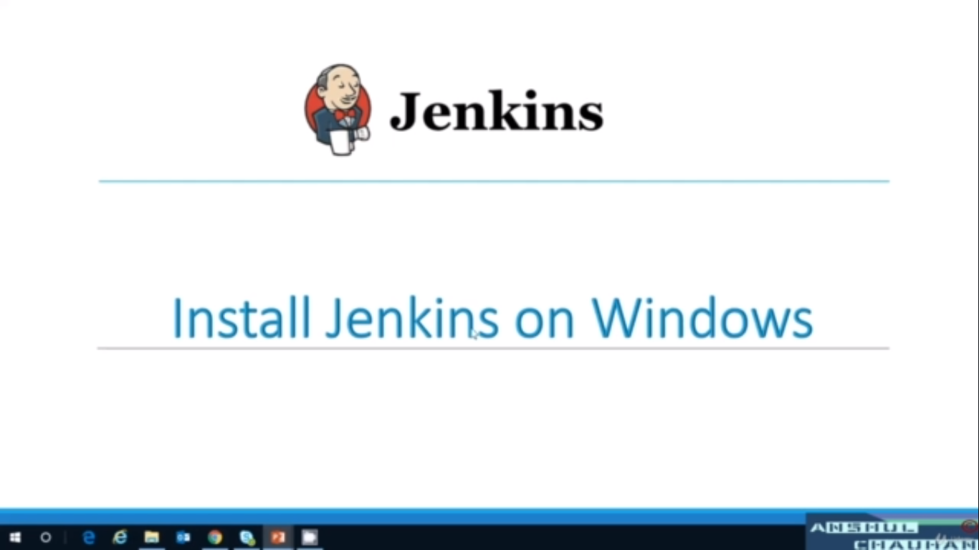

Slide 2
Download and Configure Jenkins
Download the Jenkins
Prerequisite to start jenkins service
Start Jenkins service on windows
Set Admin Account Credentials on Windows
Install default plugins on jenkins

Slide 3
Start Jenkins on Windows
1. Go to Directory, where you have kept your Jenkins.war file
2. Execute Command :
java -jar jenkins.war --httpPort={Port_number}

Slide 4
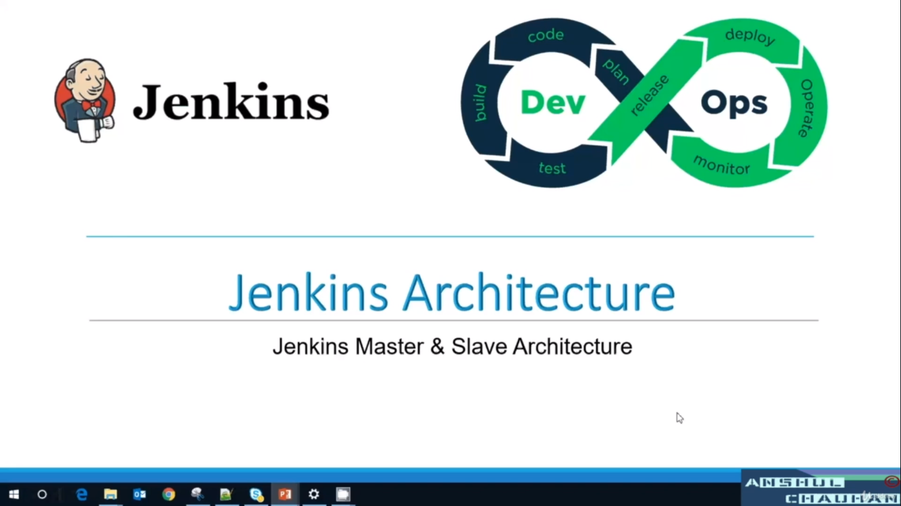

Slide 5
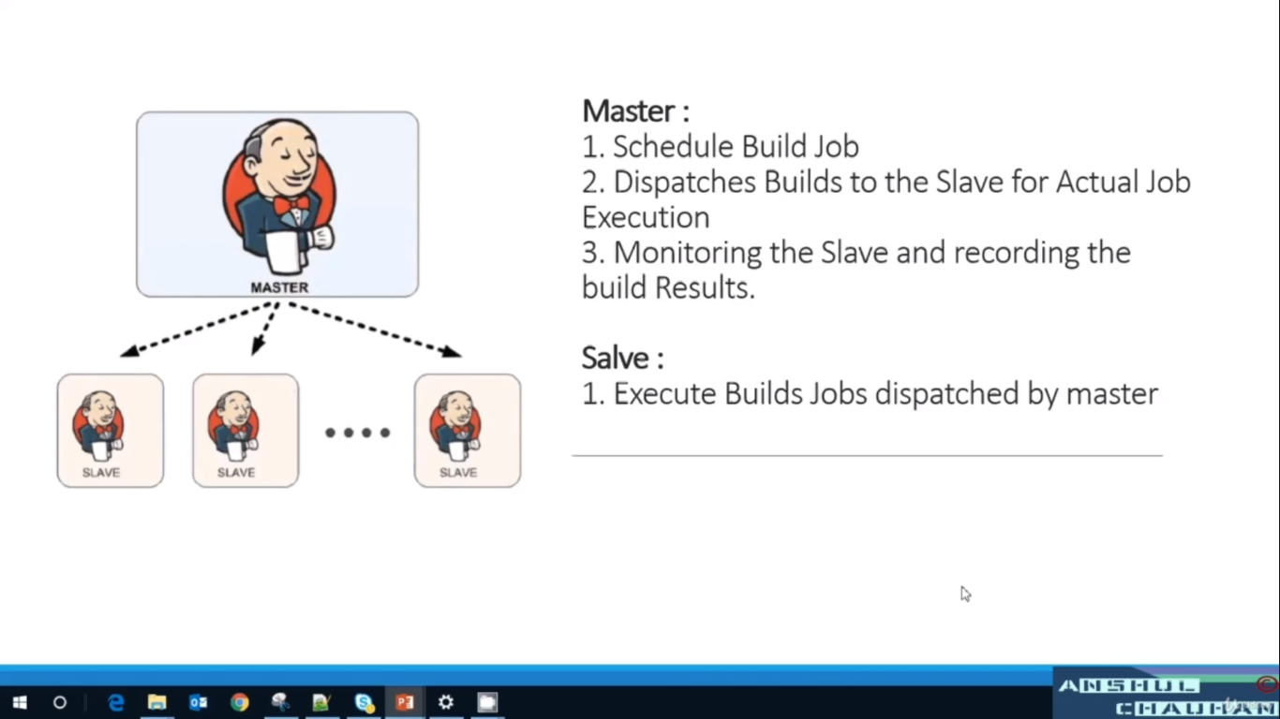

Slide 6
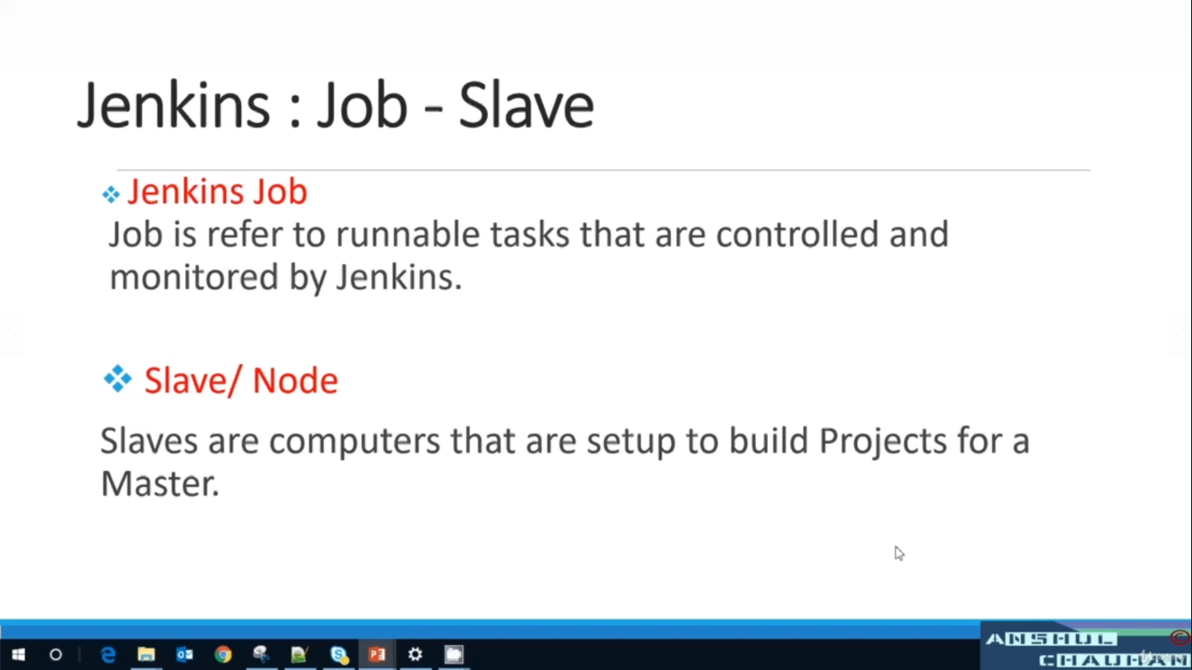

Slide 7
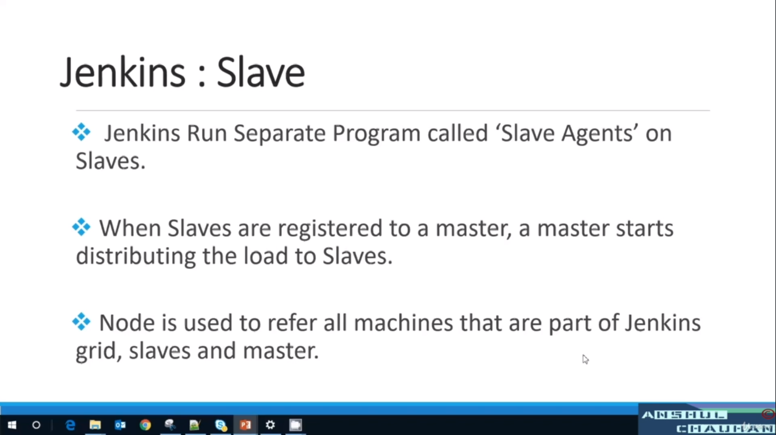

Slide 8
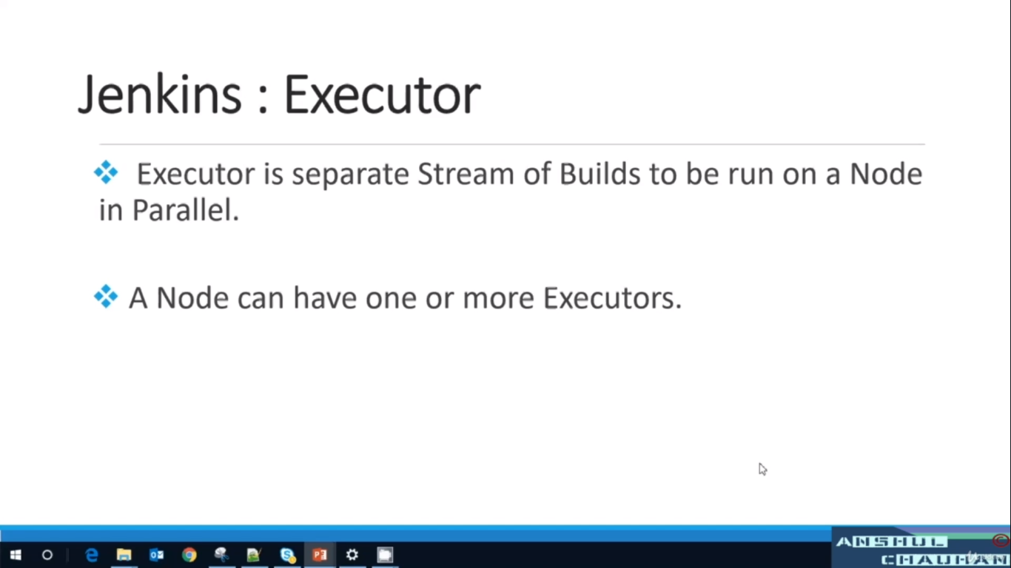

Slide 9
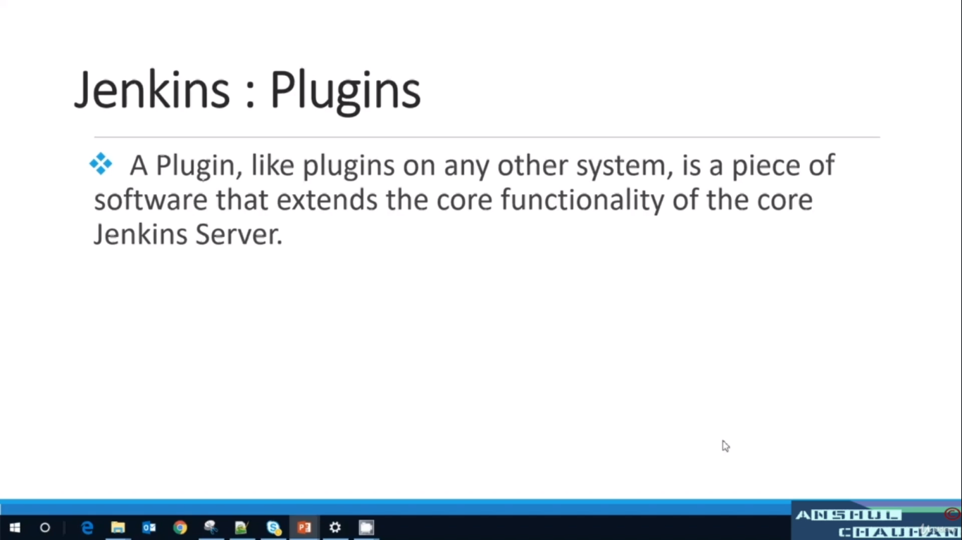

Slide 10

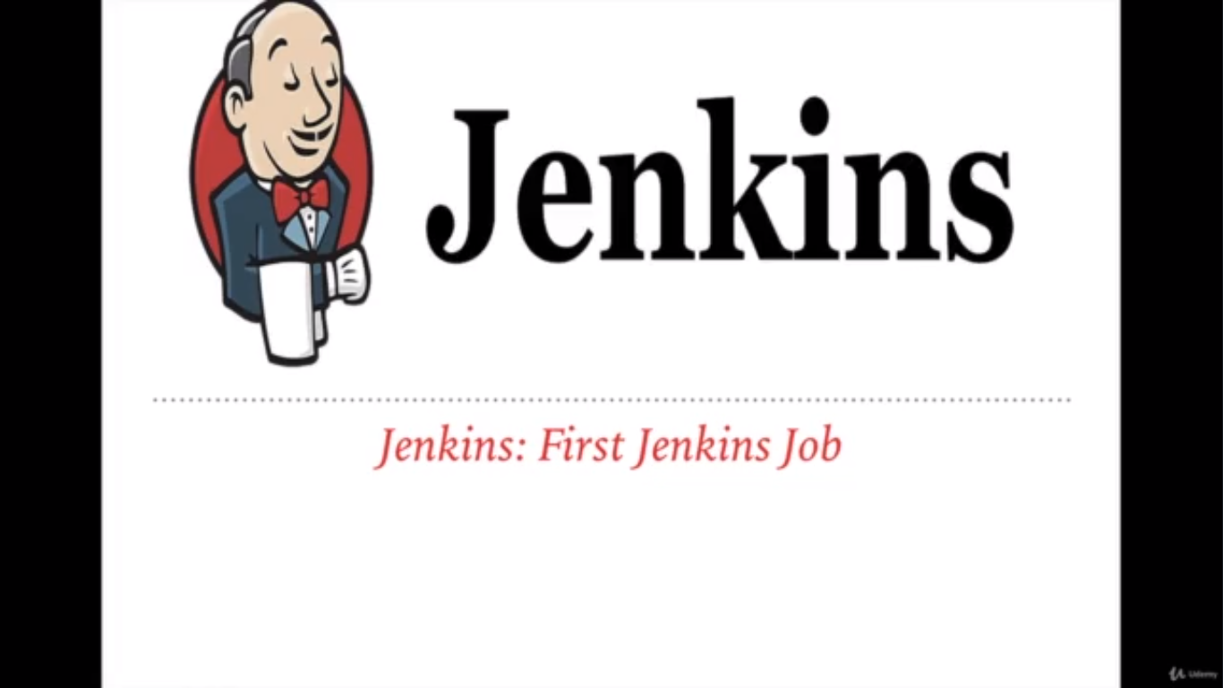

Slide 11
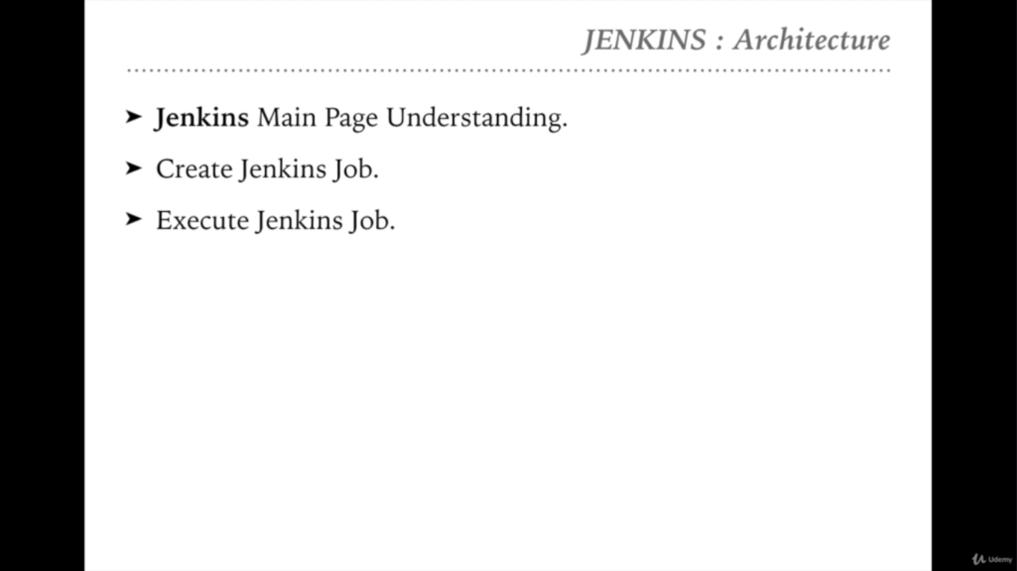

Slide 12


Slide 13
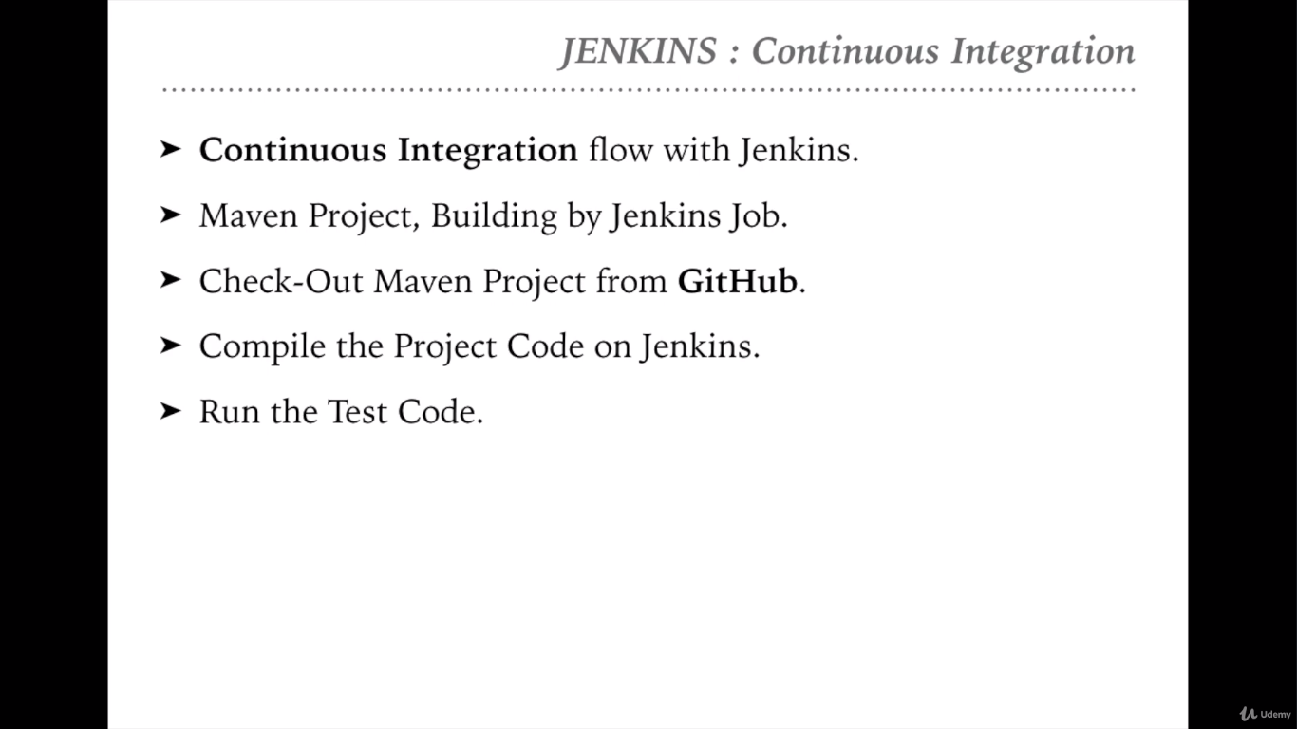

Slide 14


Slide 15
Download the maven from this location https://maven.apache.org/download.cgi and extract it in location like – D:/Latest Setup/apache-maven-3.0.4. You can choose your own location.
Include ‘maven/bin’ directory in the ‘PATH’ variable
To run a maven from the command prompt, this is necessary. Update the PATH variable with 'Maven-installation/bin' directory.

Slide 16


Slide 17


Slide 18


Slide 19
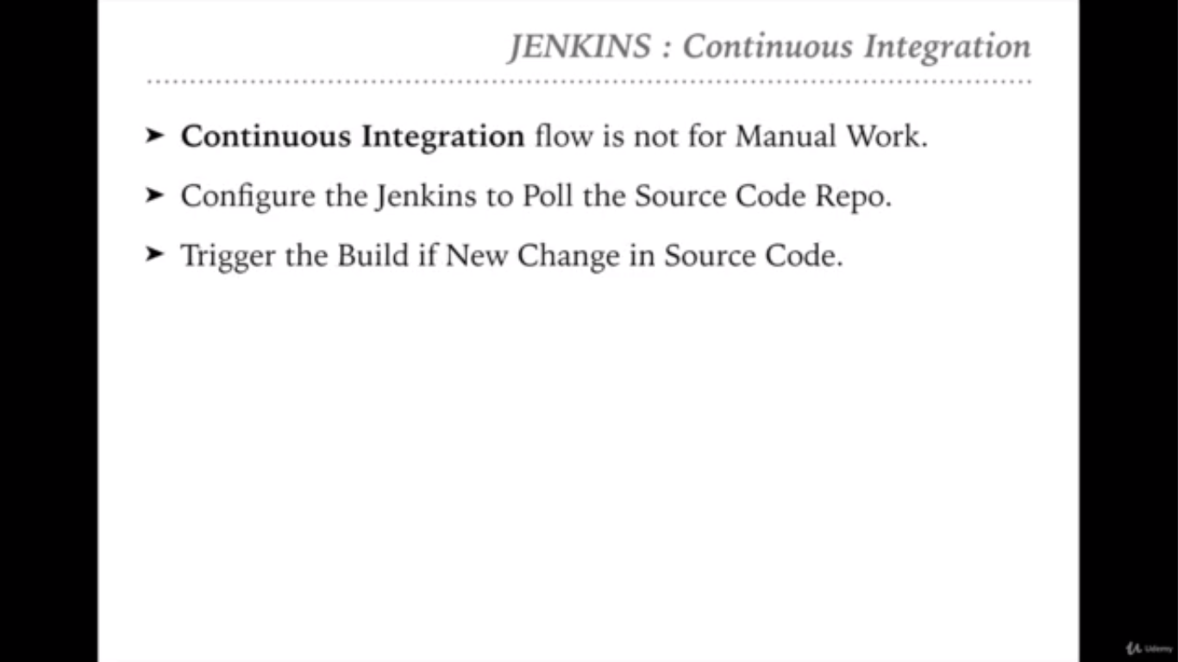

Slide 20
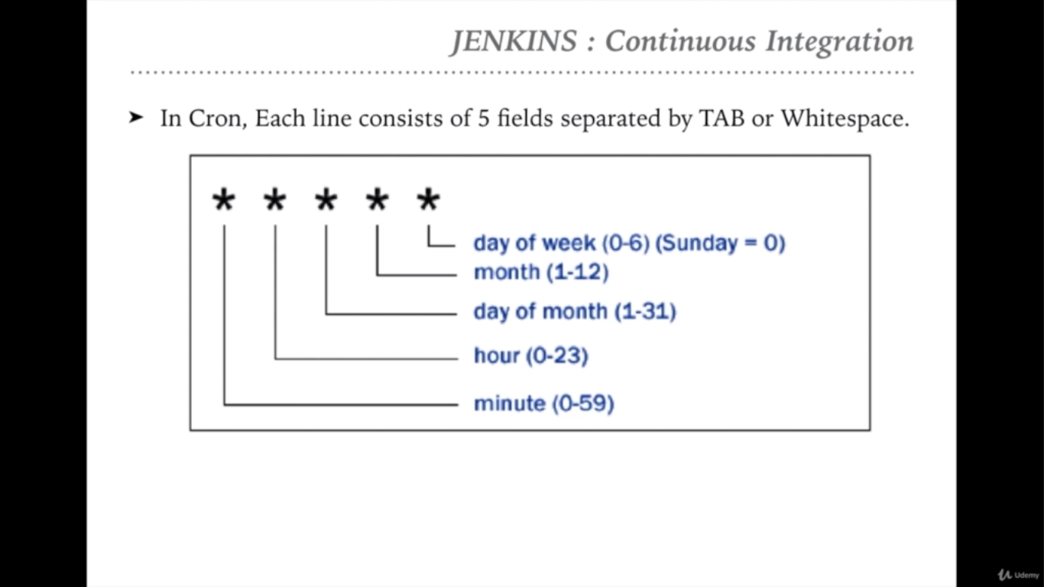

Slide 21
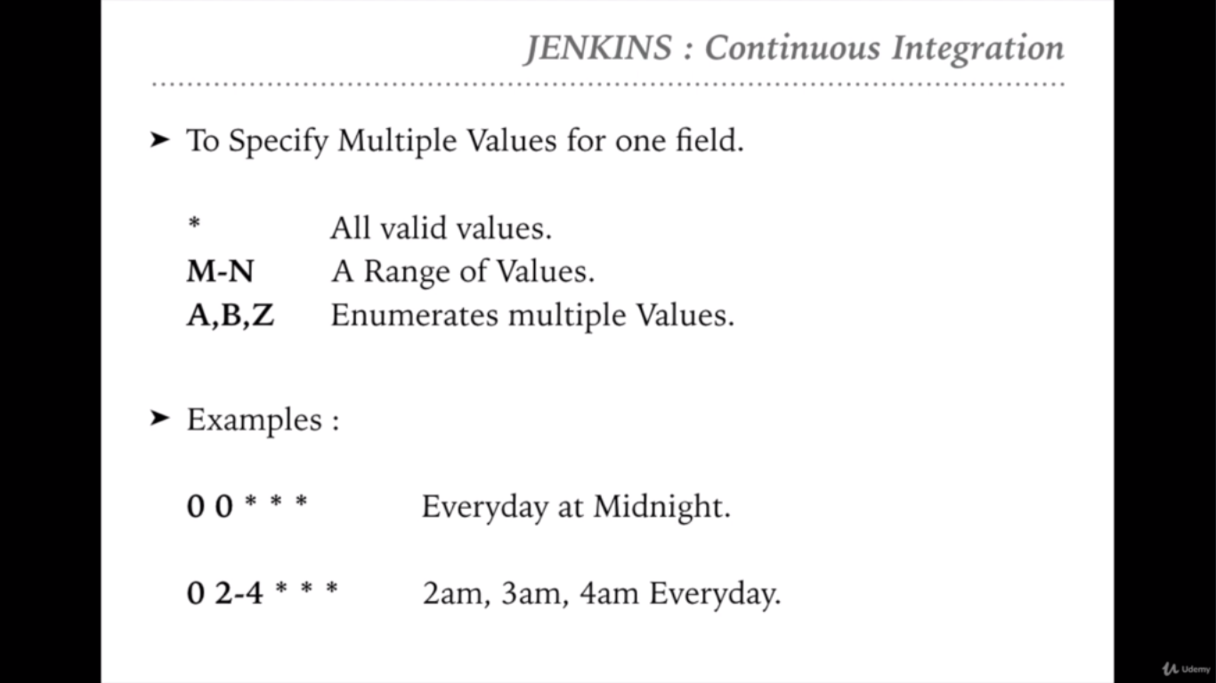

Slide 22
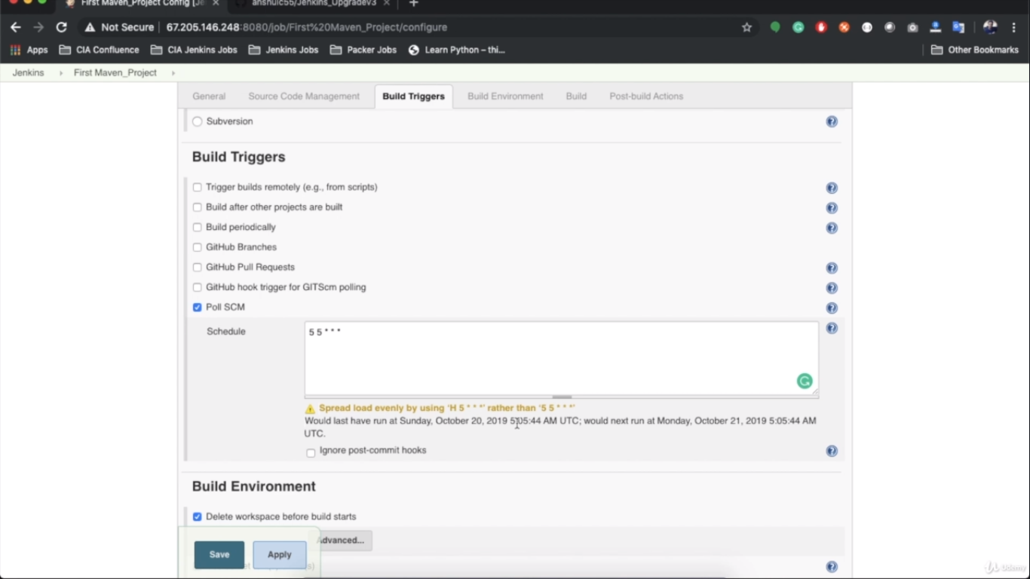

Slide 23


Slide 24
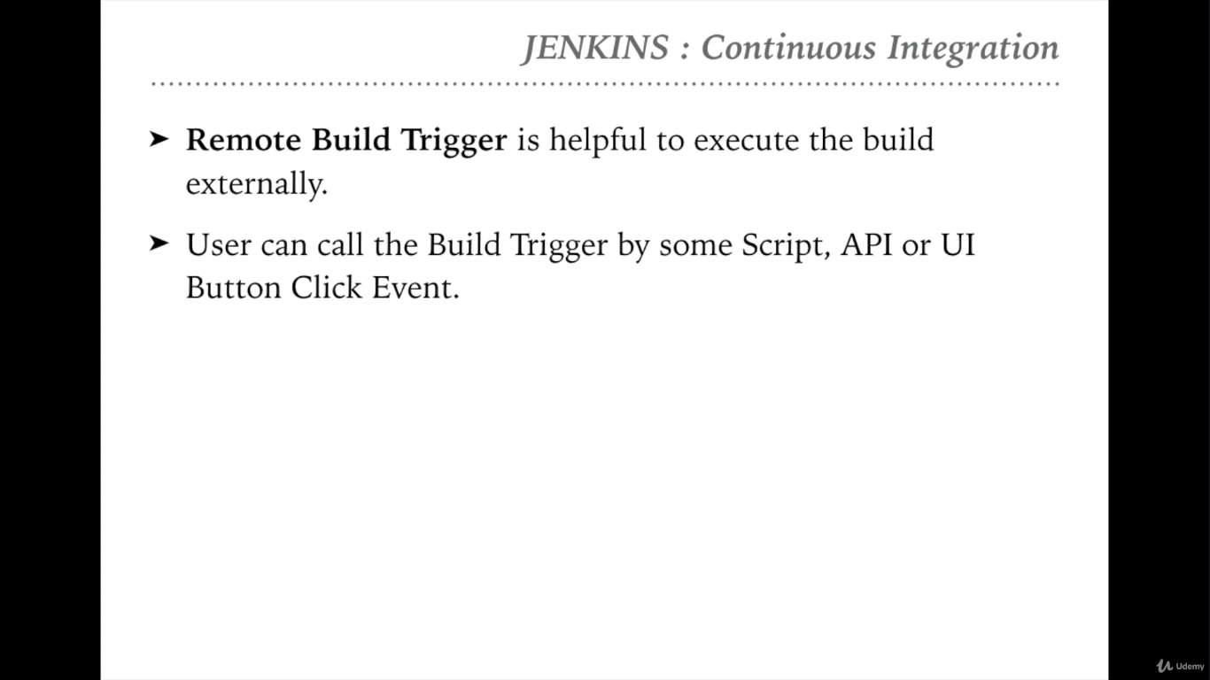

Slide 25
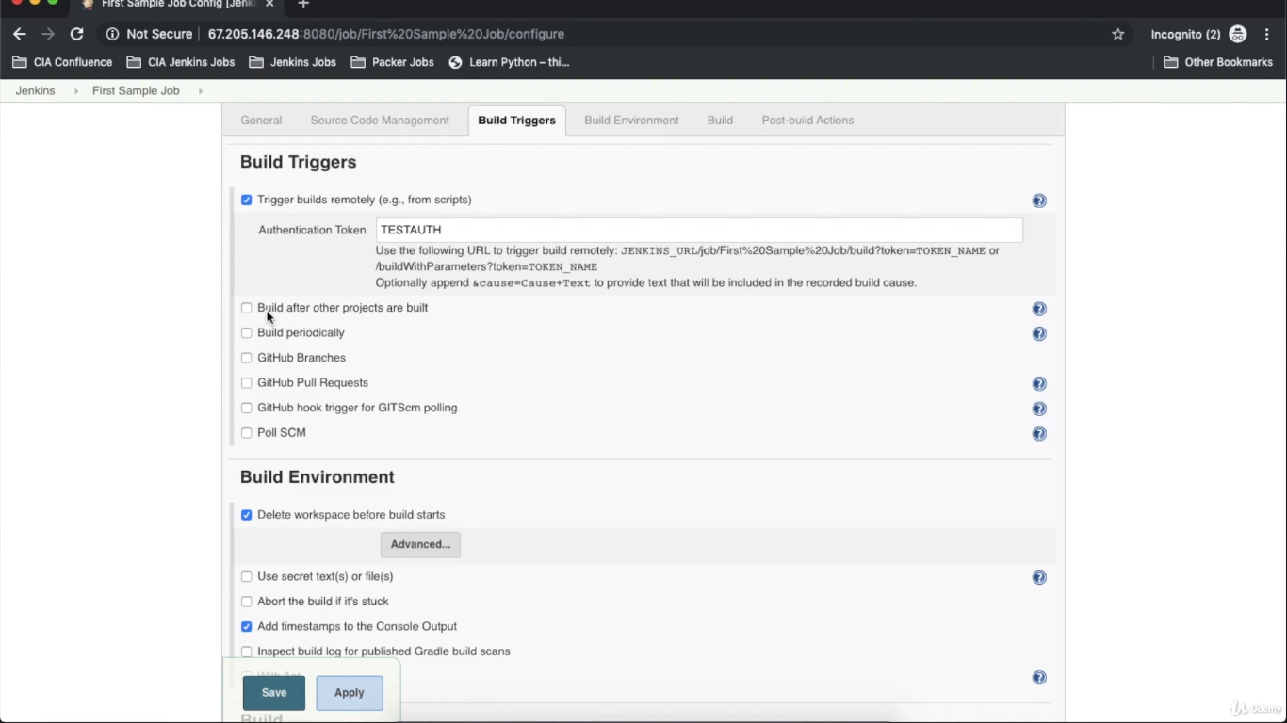

Slide 26


Slide 27
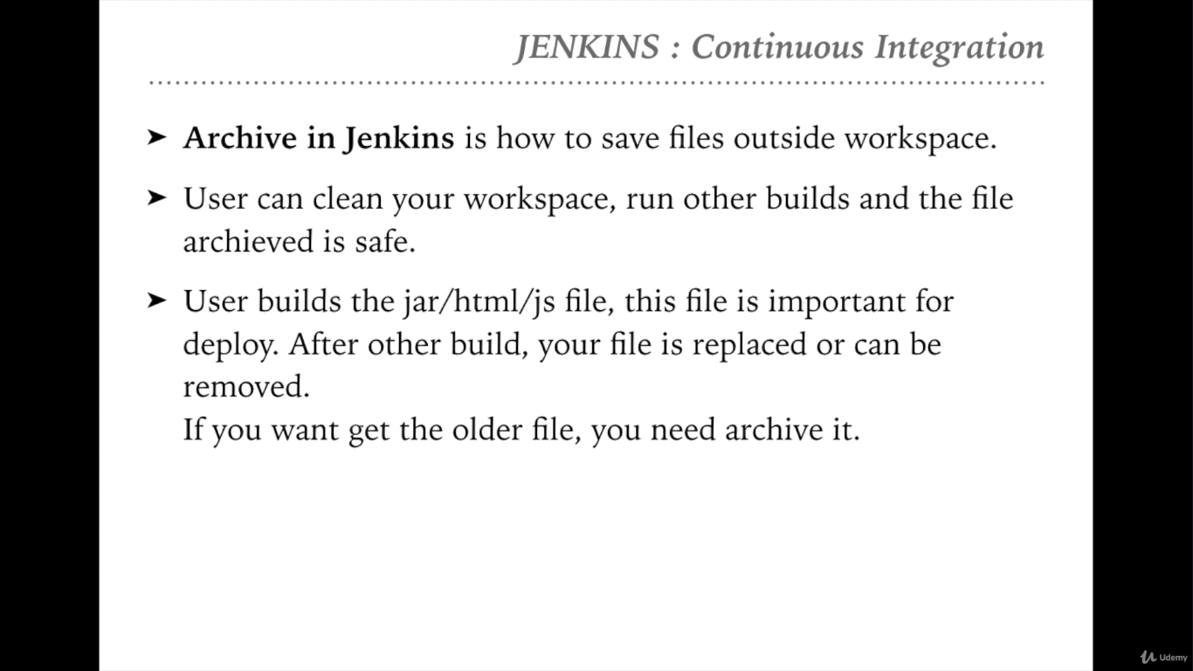

Slide 28
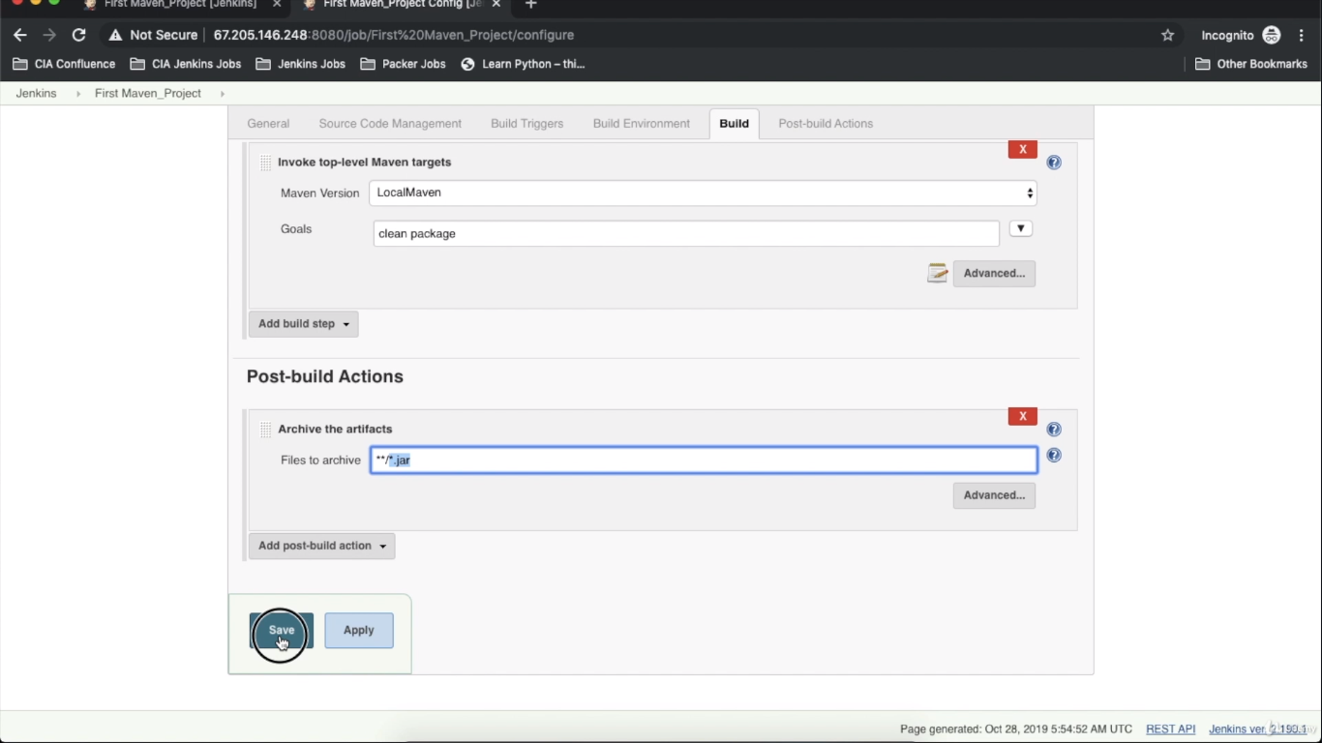

Slide 29


Slide 30
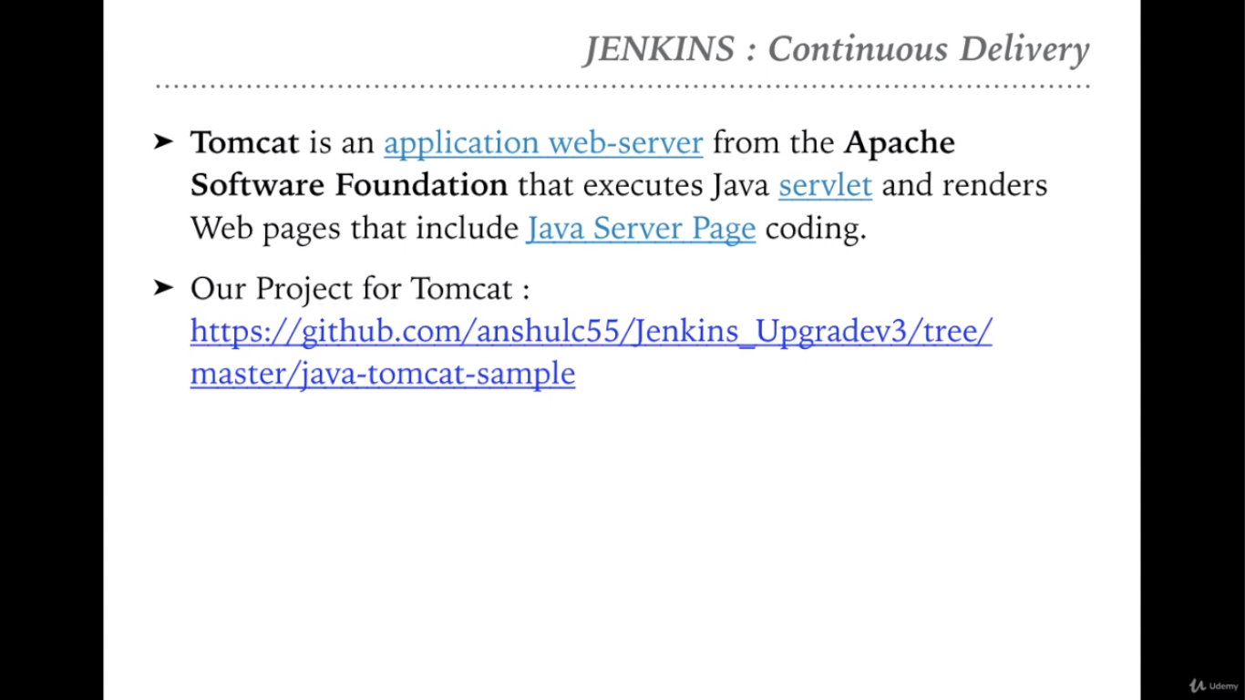
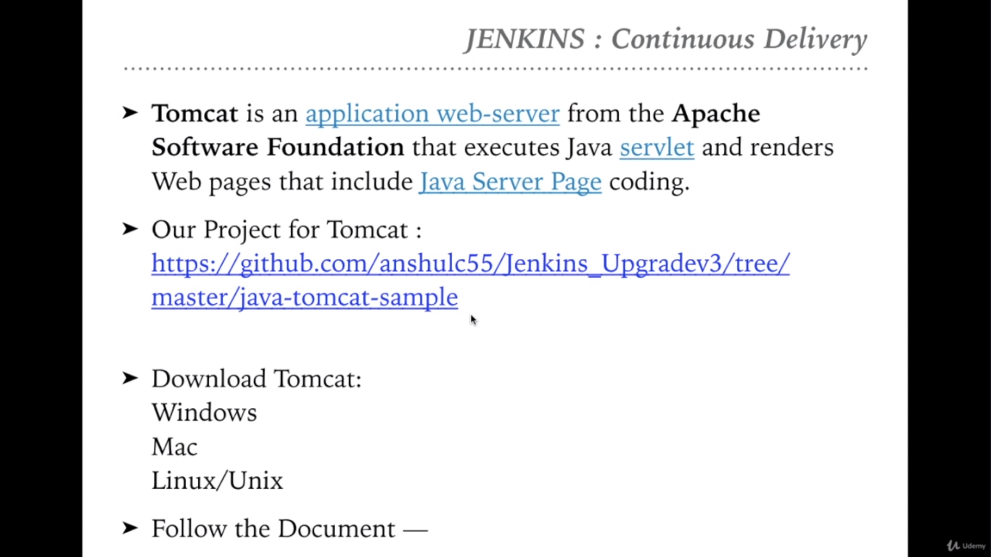

Slide 31
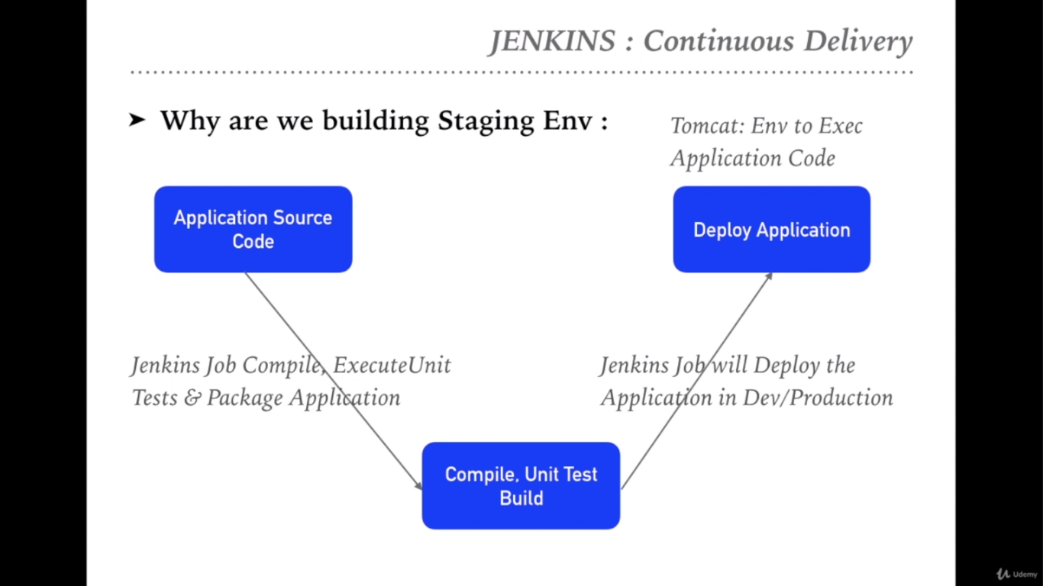

Slide 32
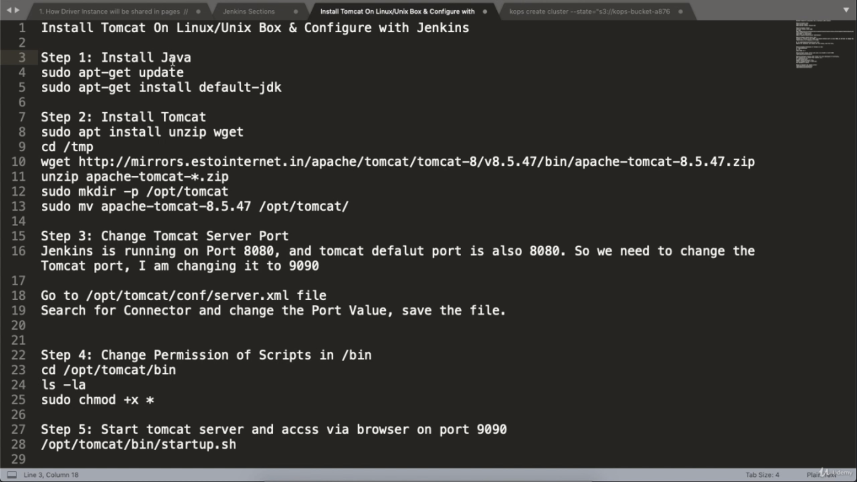

Slide 33
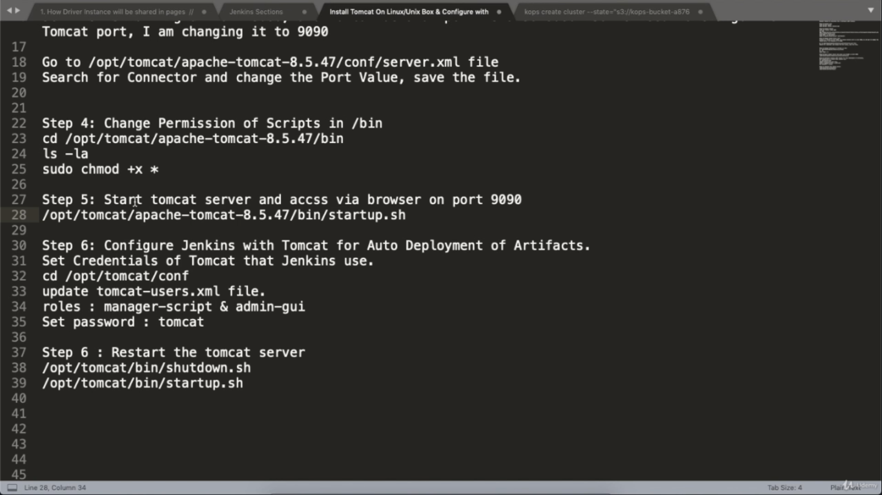

Slide 34


Slide 35
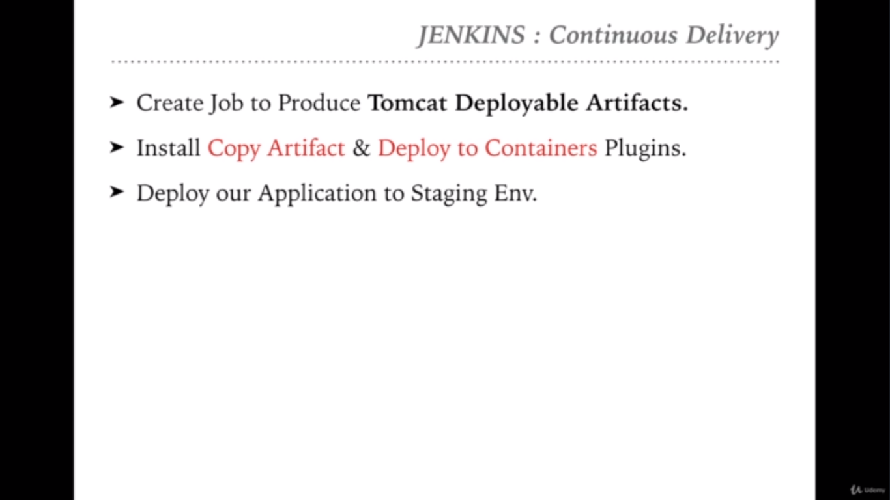

Slide 36
Create the another view say “Deploy the artifacts from another project”
Give the required changes in the ‘Manage Jenkins’ option
Trigger the build now option which will copy the artifacts from the selected project to this newly created view i.e., Deploy the artifacts
Execute http://localhost:8080/ URL and see the result on page.

Slide 37
How to make both jobs dependent?
Go to Job1 i.e., “Package Tomcat Application” and click on Configure button
Go to Post-build Actions tab
Select ‘Build other projects’ from drop-down and enter the job2 name i.e., Deploy the artifacts from another project

Slide 38


Slide 39
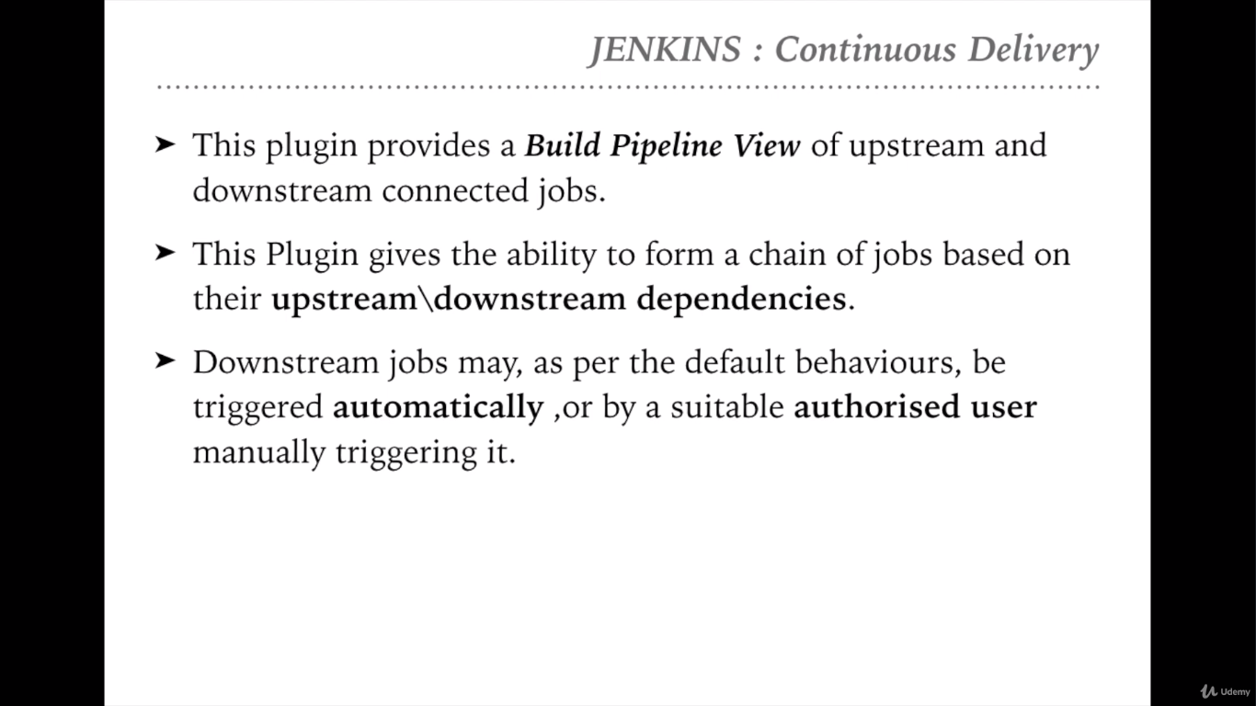

Slide 40
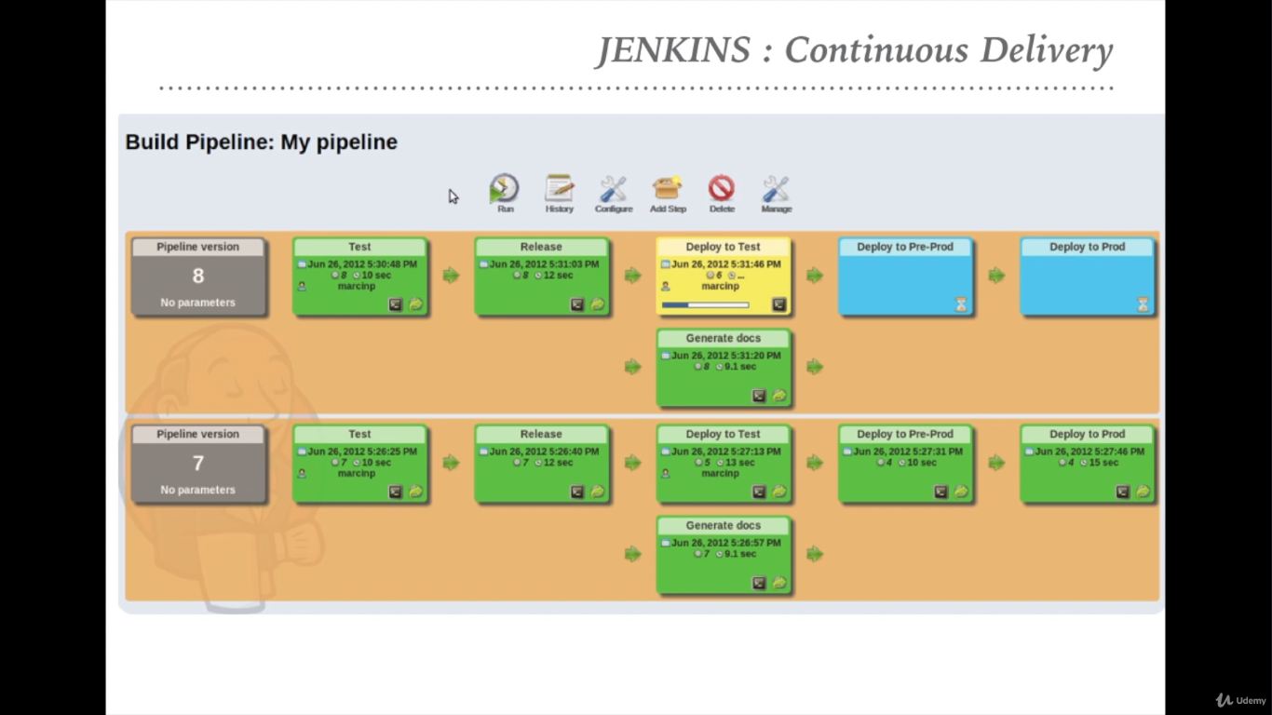

Slide 41
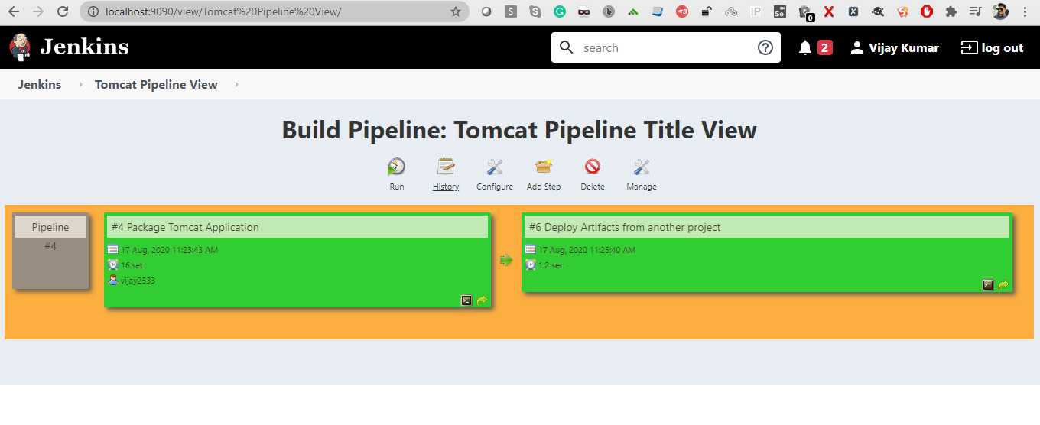

Slide 42


Slide 43
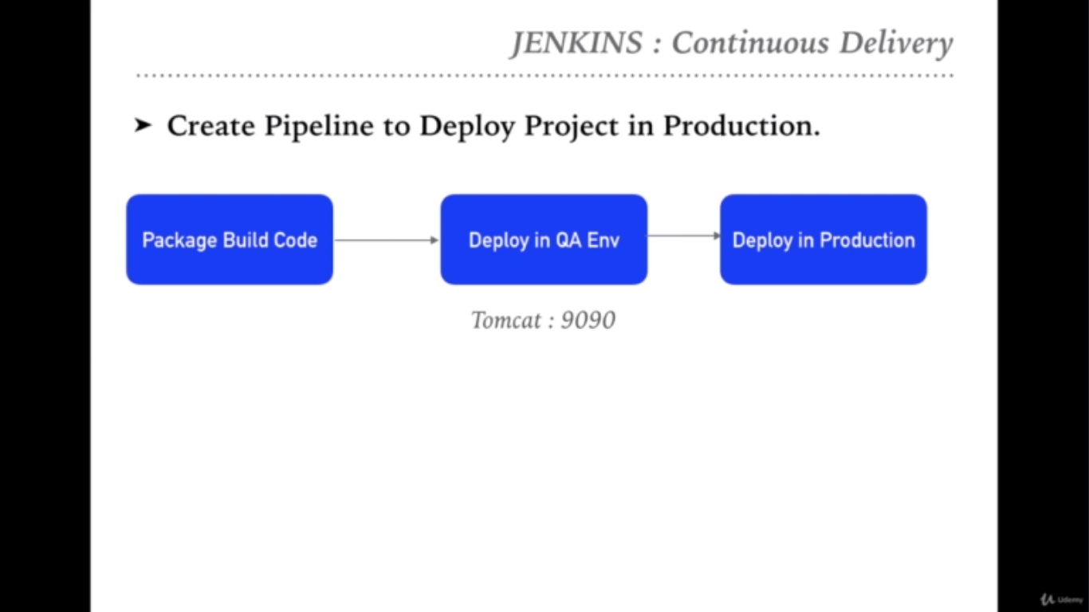
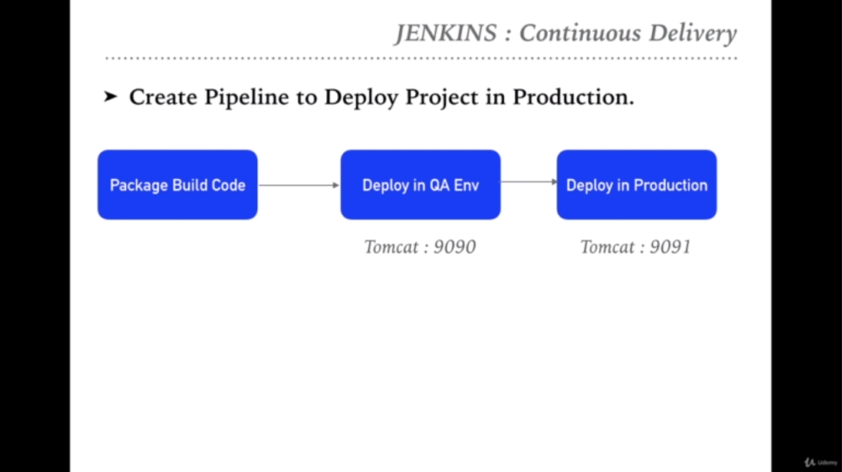

Slide 44


Slide 45
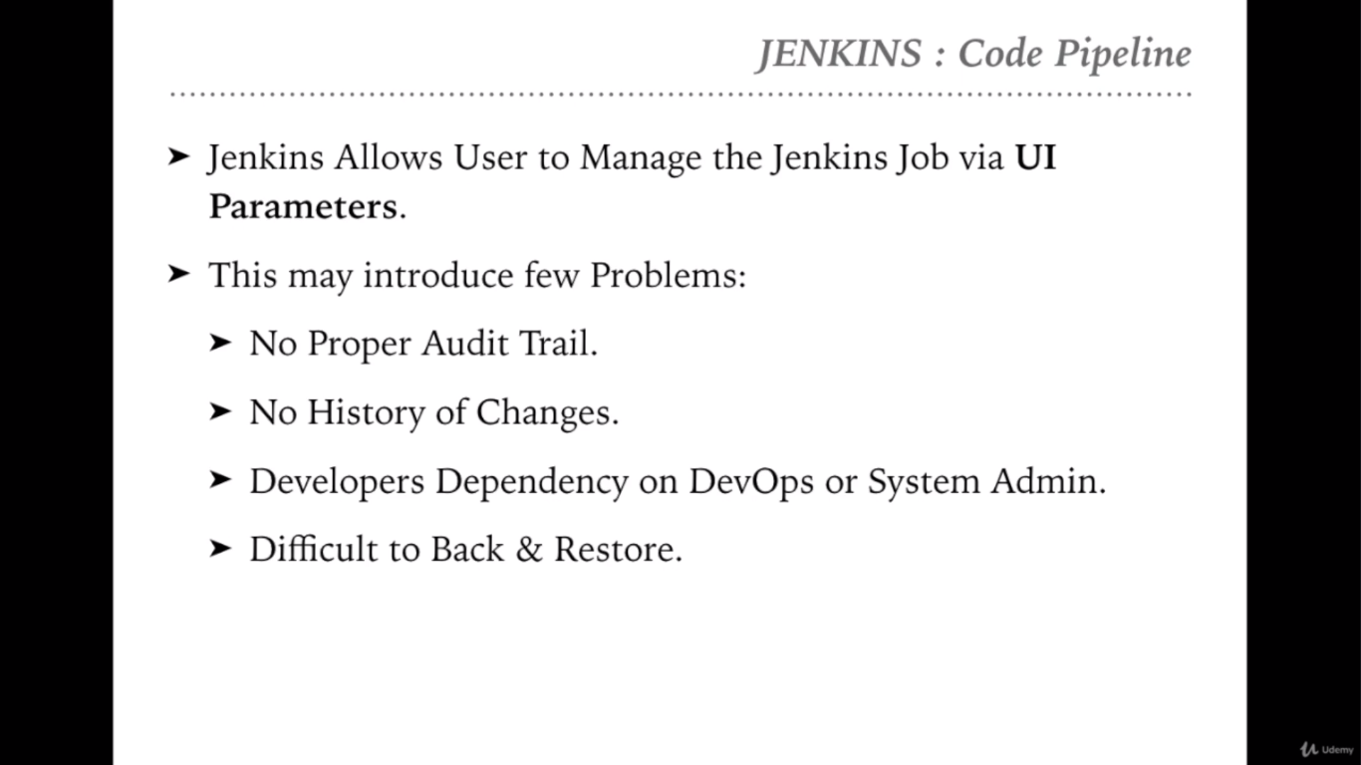

Slide 46
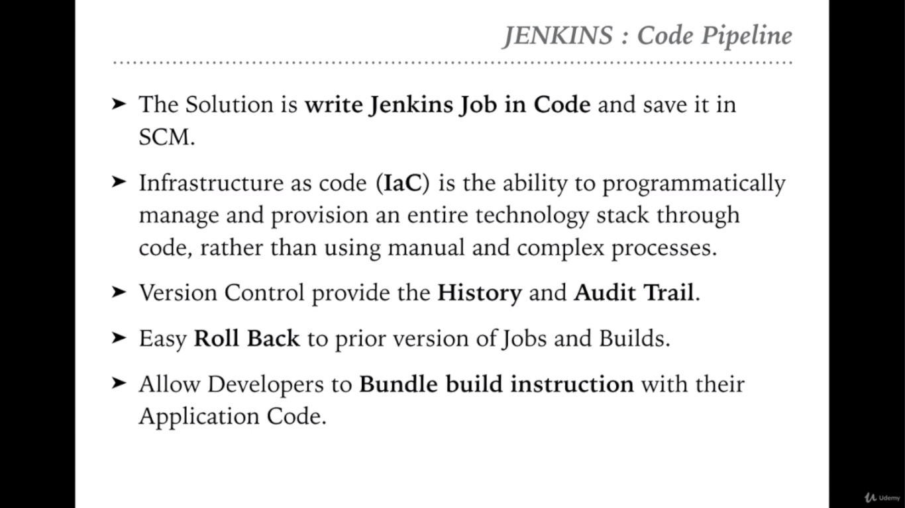

Slide 47


Slide 48
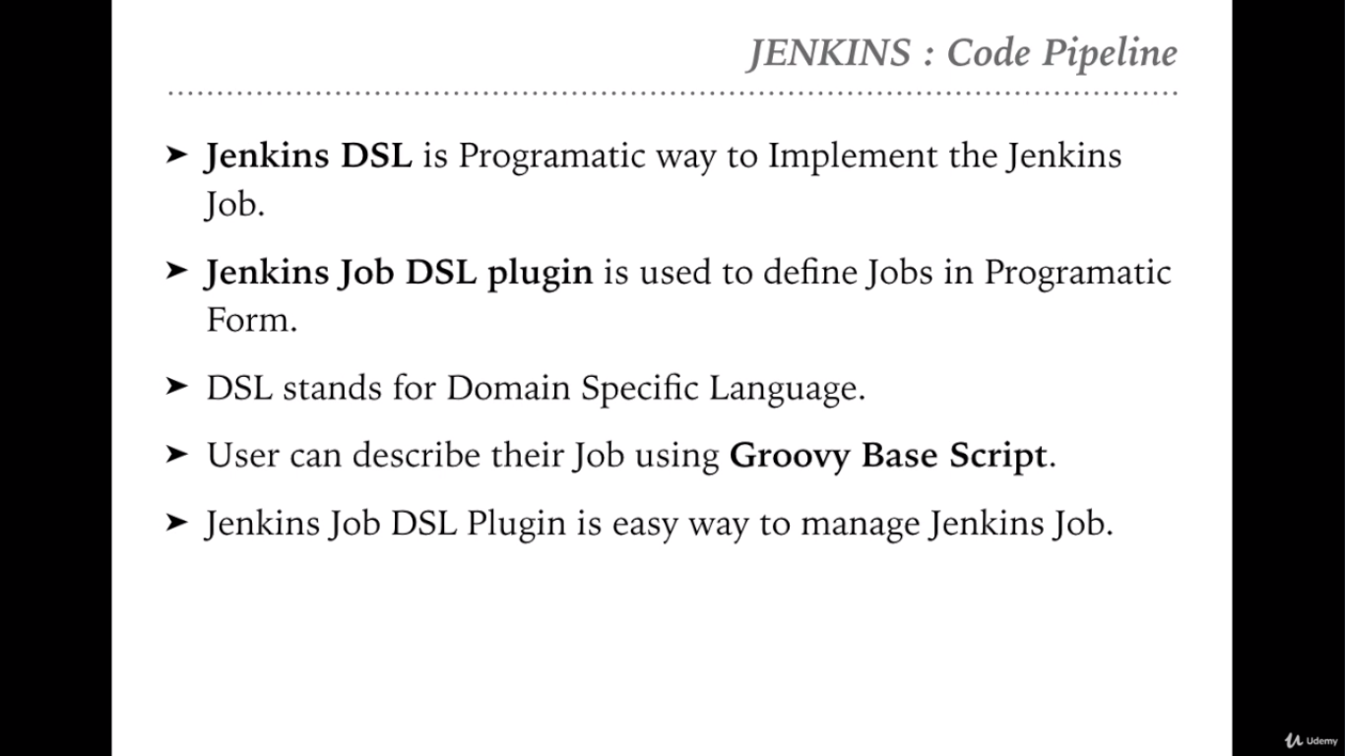

Slide 49
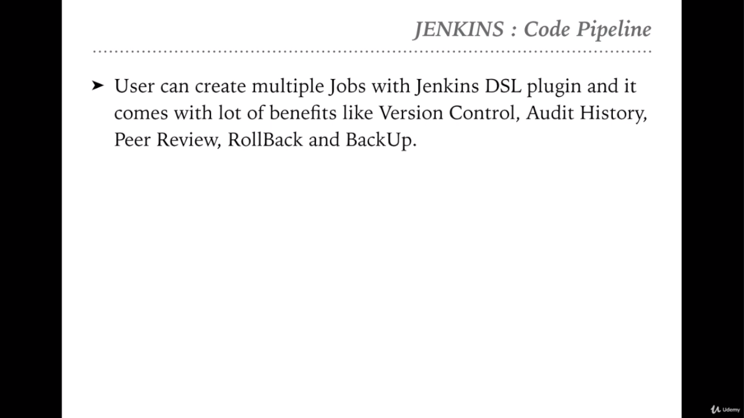

Slide 50


Slide 51
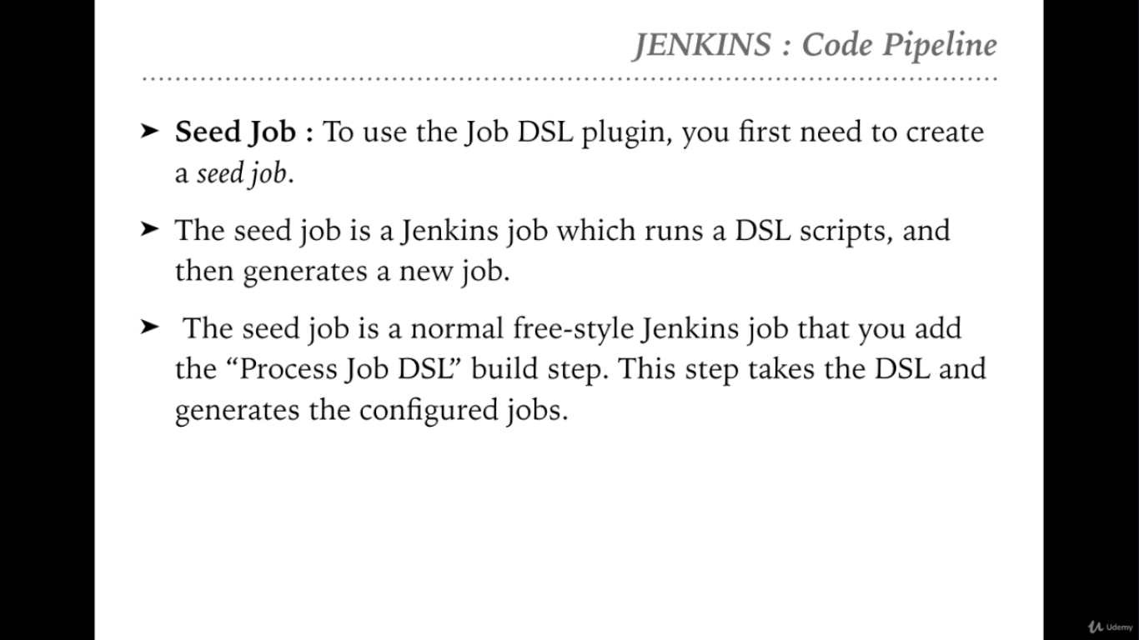

Slide 52


Slide 53
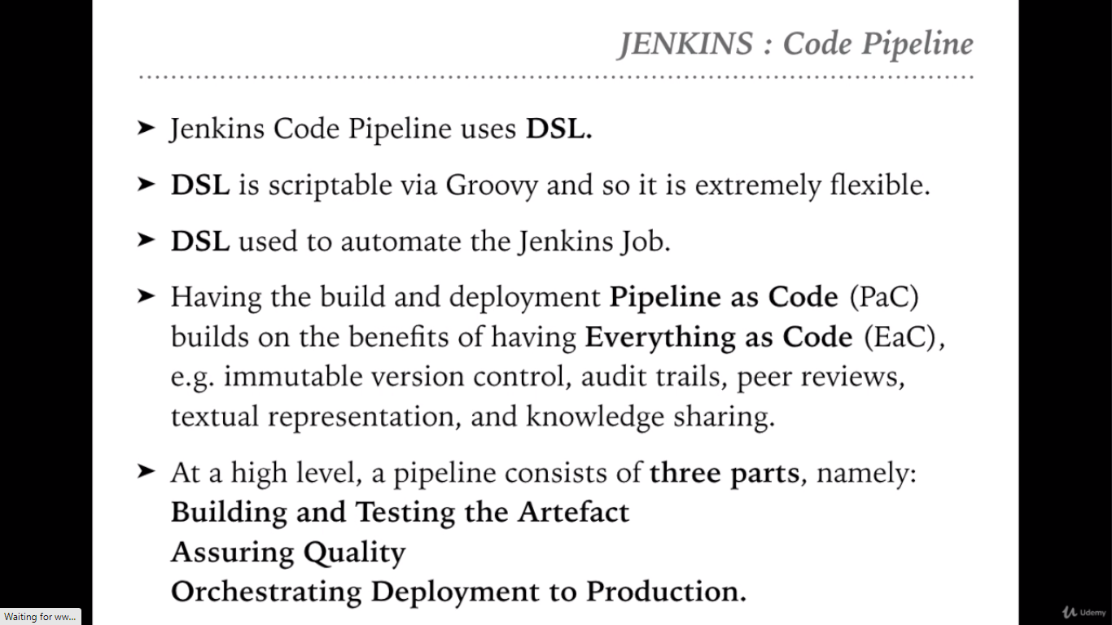

Slide 54
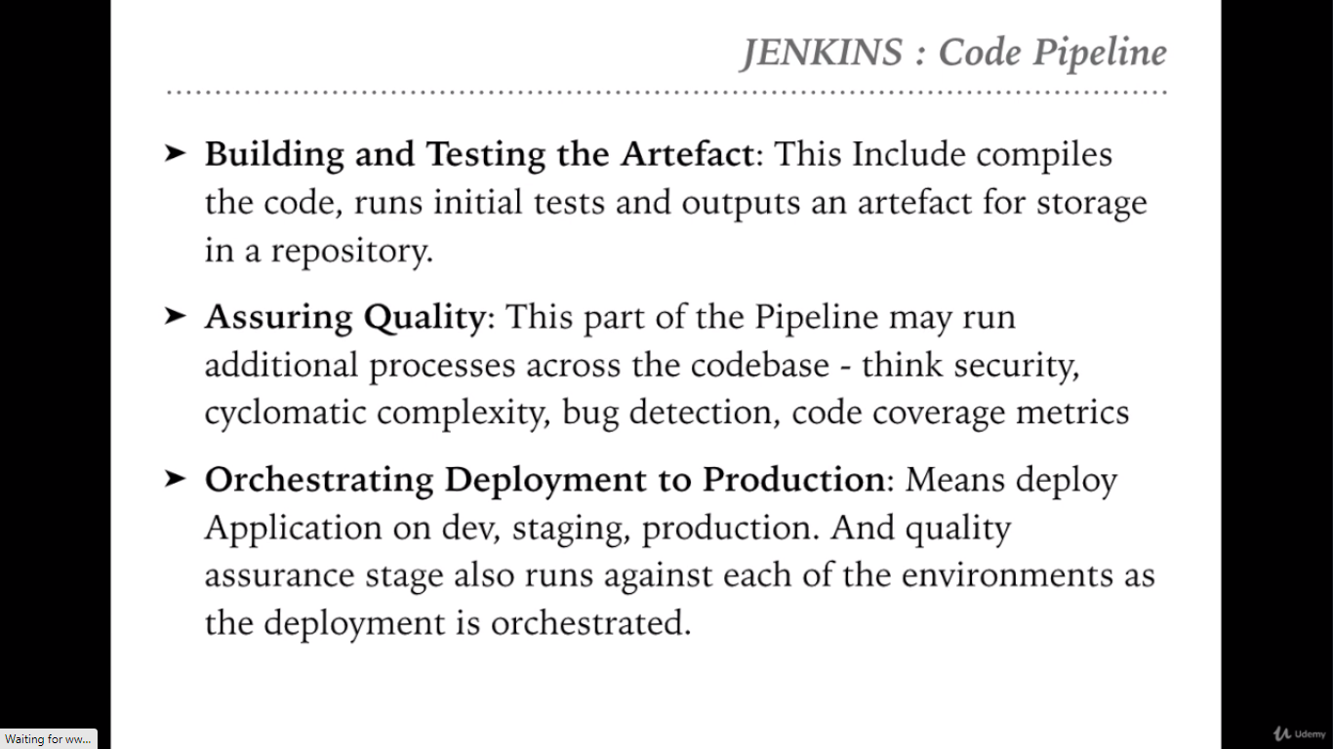

Slide 55


Slide 56
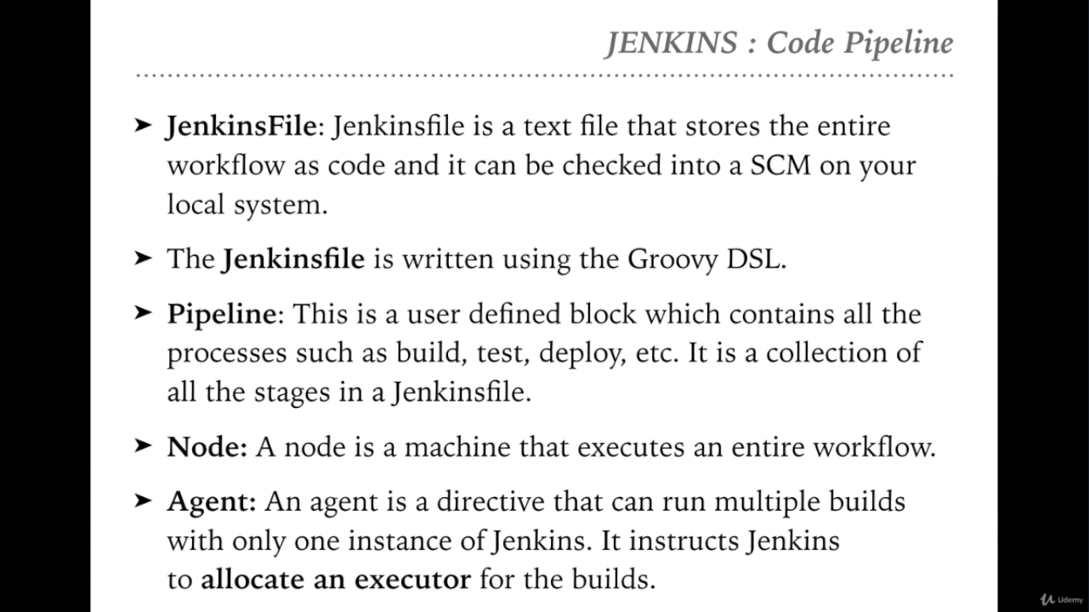

Slide 57
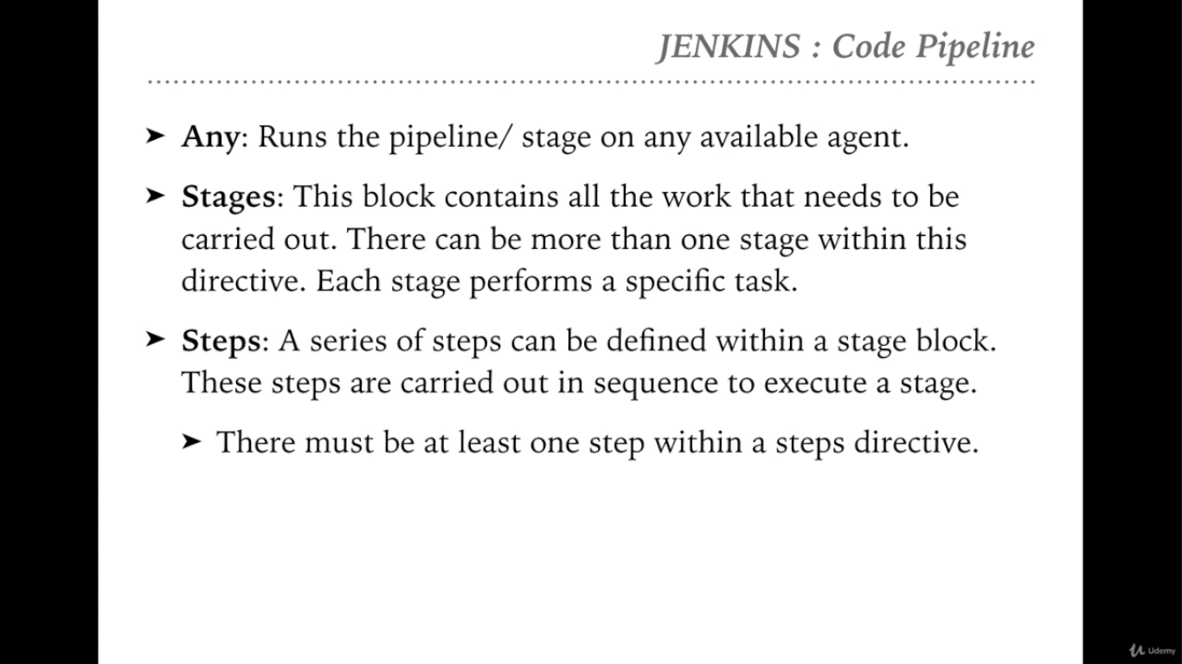

Slide 58


Slide 59
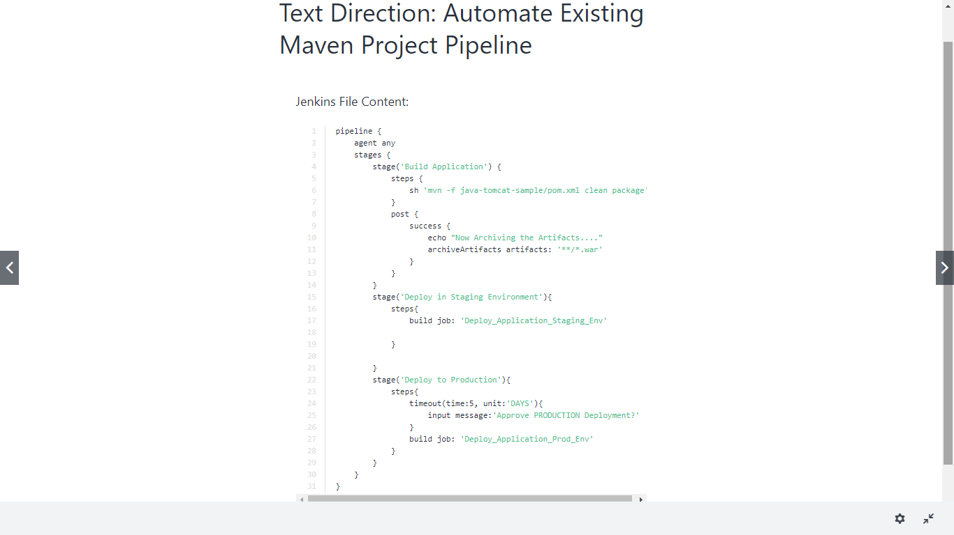

Slide 60
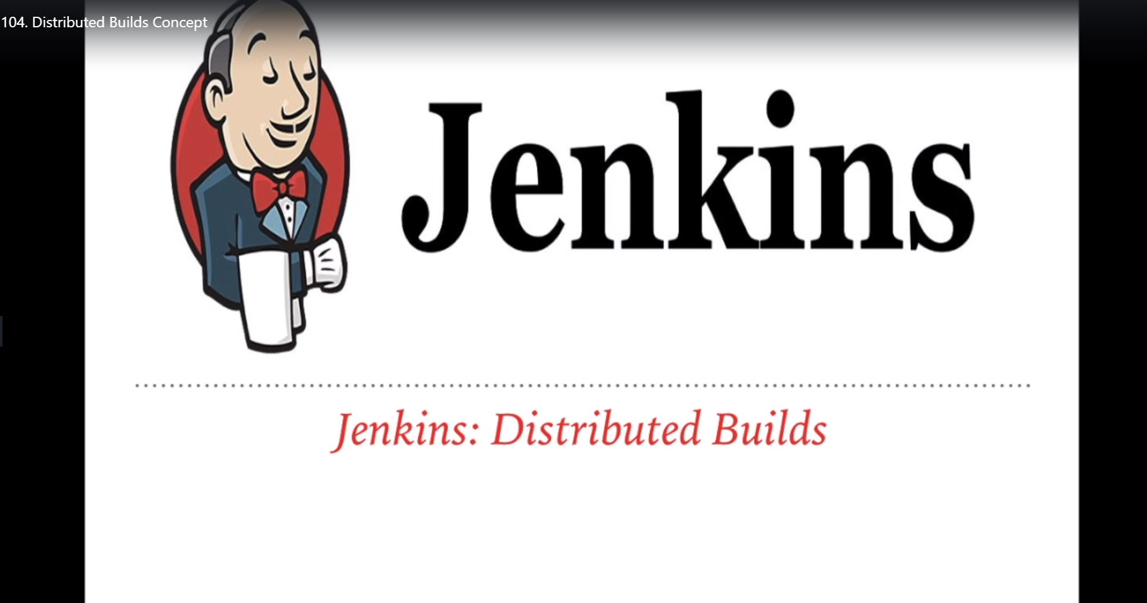

Slide 61
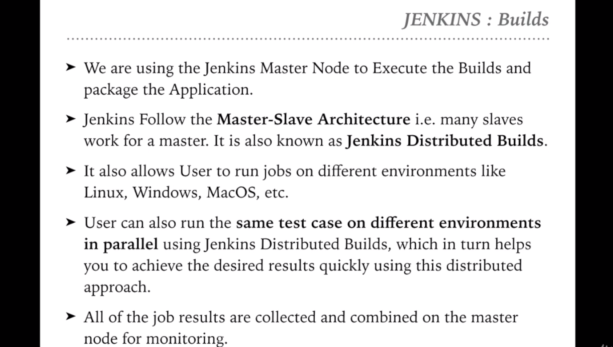

Slide 62
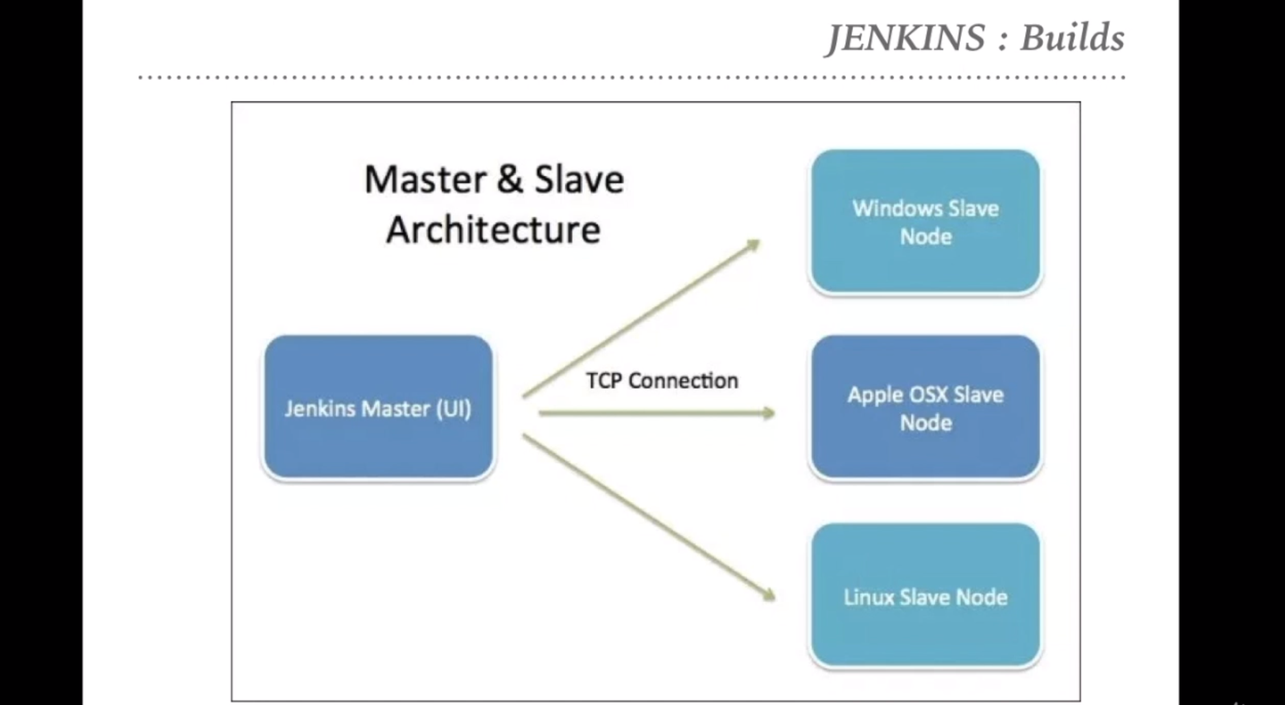

Slide 63
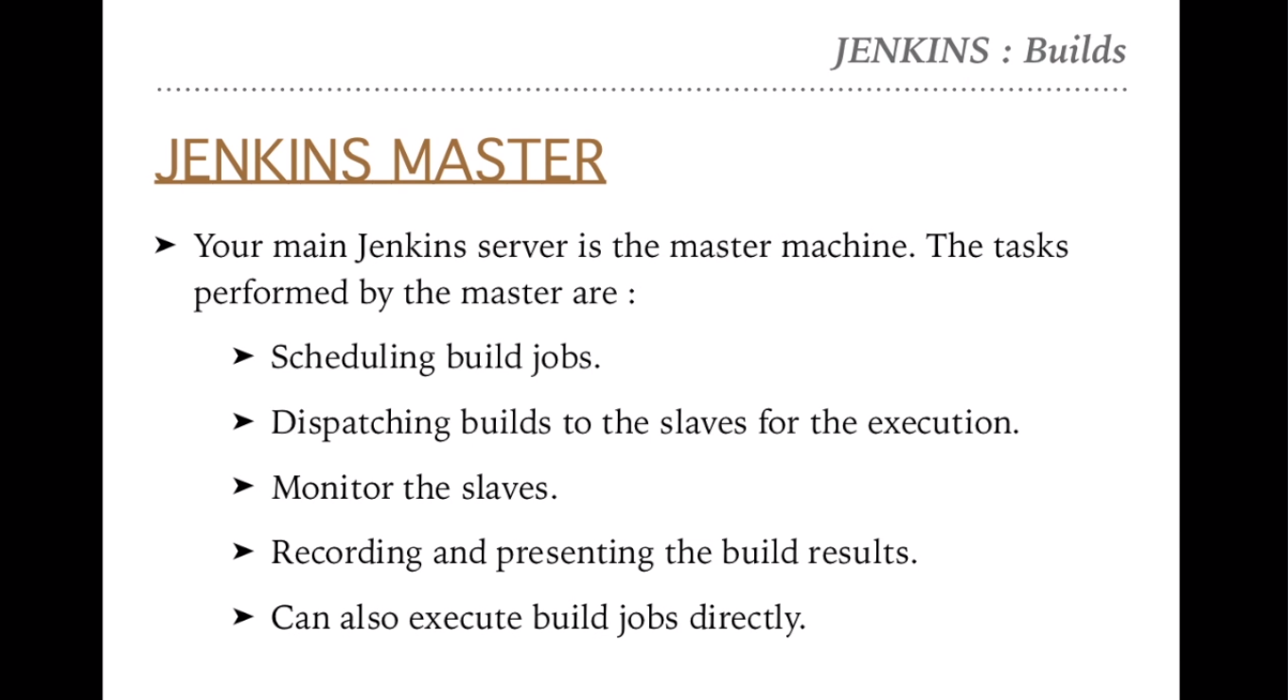

Slide 64
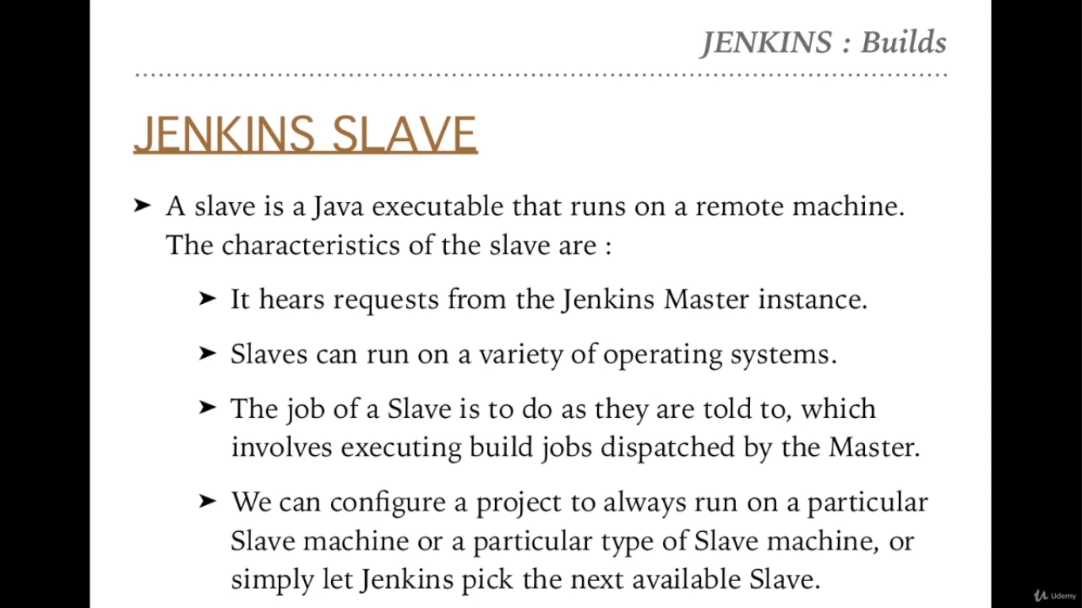

Slide 65


Slide 66
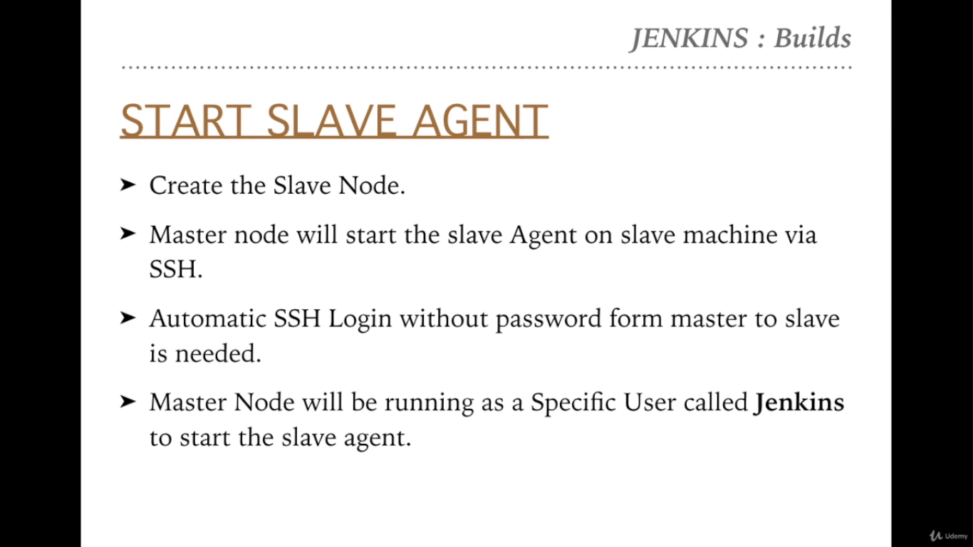

Slide 67
Automatic SSH login without password
ssh-keygen -t rsa
ssh root@134.122.103.160 mkdir -p .ssh
cat /var/lib/jenkins/.ssh/id_rsa | ssh root@134.122.103.160 'cat >> .ssh/authorized_keys'
ssh root@134.122.103.160

Slide 68
Install Jenkins Agent on the Slave Node
Running on the master node:
sudo -iu jenkins
ssh root@<slave_ip> mkdir -p .ssh
cat .ssh/id_rsa.pub | ssh root@<slave_ip> 'cat >> .ssh/authorized_keys'
Running on slave node:
mkdir bin
cd bin
wget http://<master_ip>:8080/jnlpJars/slave.jar

Slide 69
Verify and Install Java:
java -version
sudo add-apt-repository ppa:webupd8team/java
sudo apt-get update
sudo apt install openjdk-8-jdk
Start Slave Agent Command:
ssh root@<slave_ip> java -jar /root/bin/slave.jar
Troubleshooting
If you don't see the "Launch agent via execution of command on master" option in the add slave page. This is due to the fact that the latest version of Jenkins has removed that option from the default install and moved it to this plugin: https://plugins.jenkins.io/command-launcher
The solution is to install the command-launcher Jenkins plugin first before you can add a slave.

Slide 70
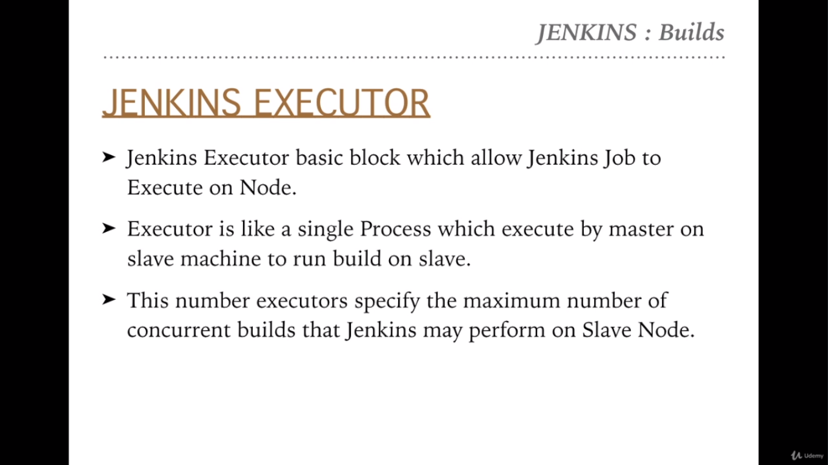

Slide 71


Slide 72
Create the concurrent jobs and execute those multiple jobs
Based on the executor of nodes then jobs will be taken care. For Example, if the slave node has executor 2 then the 2 jobs at a time will be execute and rest will be in waiting list.
Configure the concurrent job running using the labels setted for the nodes. So that jobs will be run and distribute to that particular node
Prerequisite: Make sure that slave agent should be run on the slave nodes. And we should not be put load on master node because master machine has lot more tasks to do.

Slide 73


Slide 74
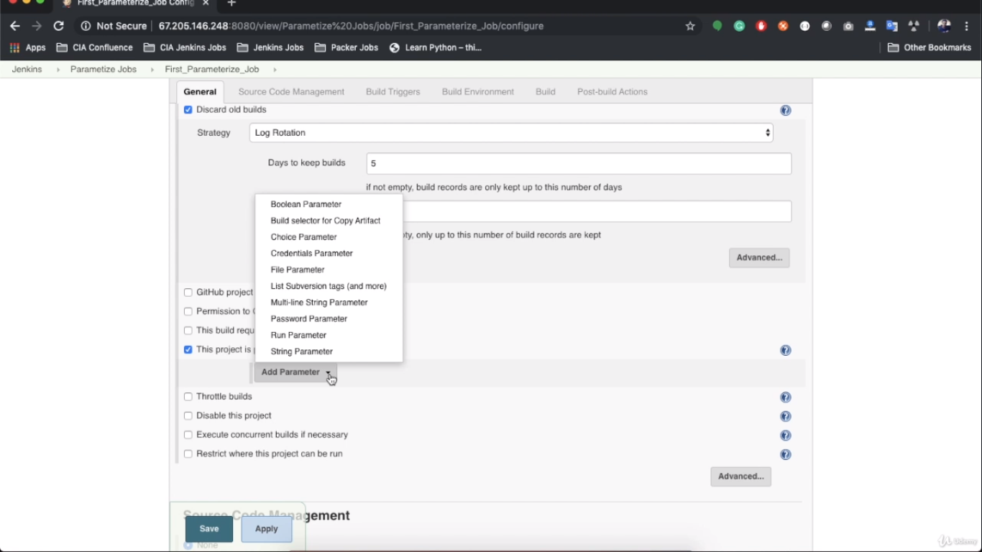

Slide 75
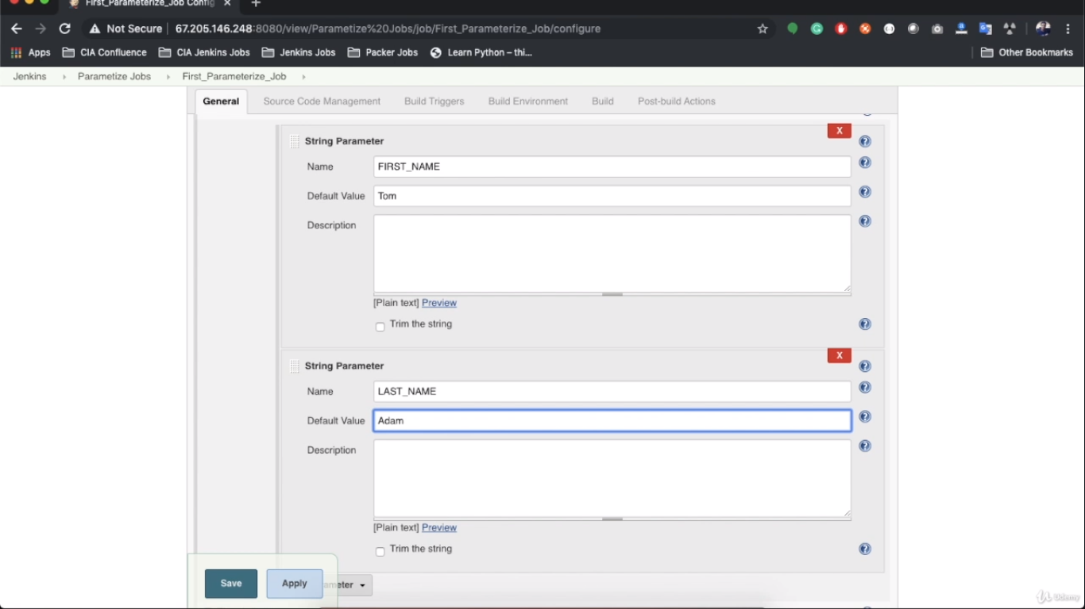

Slide 76
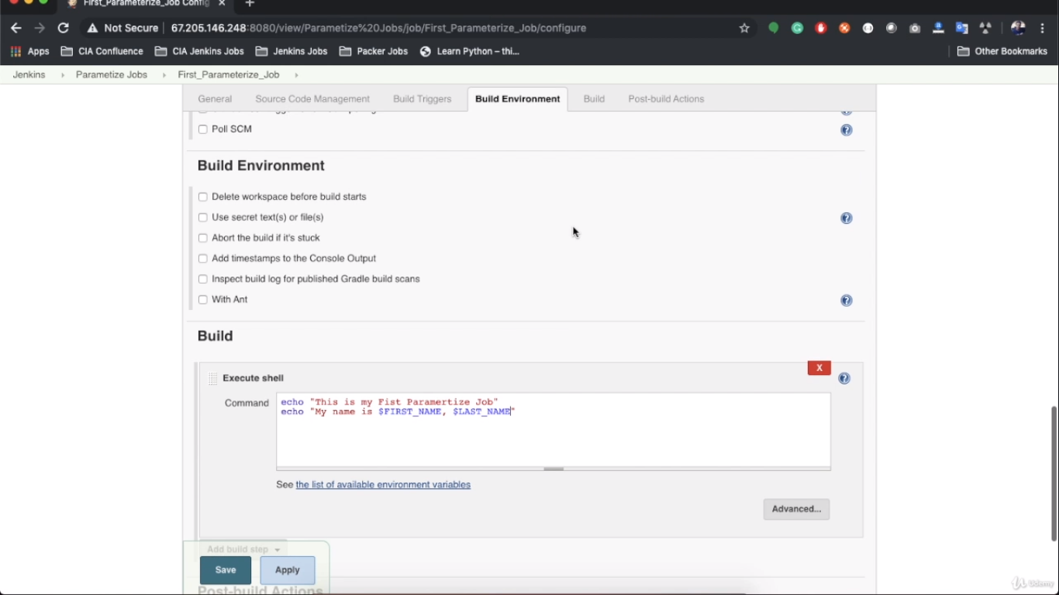

Slide 77
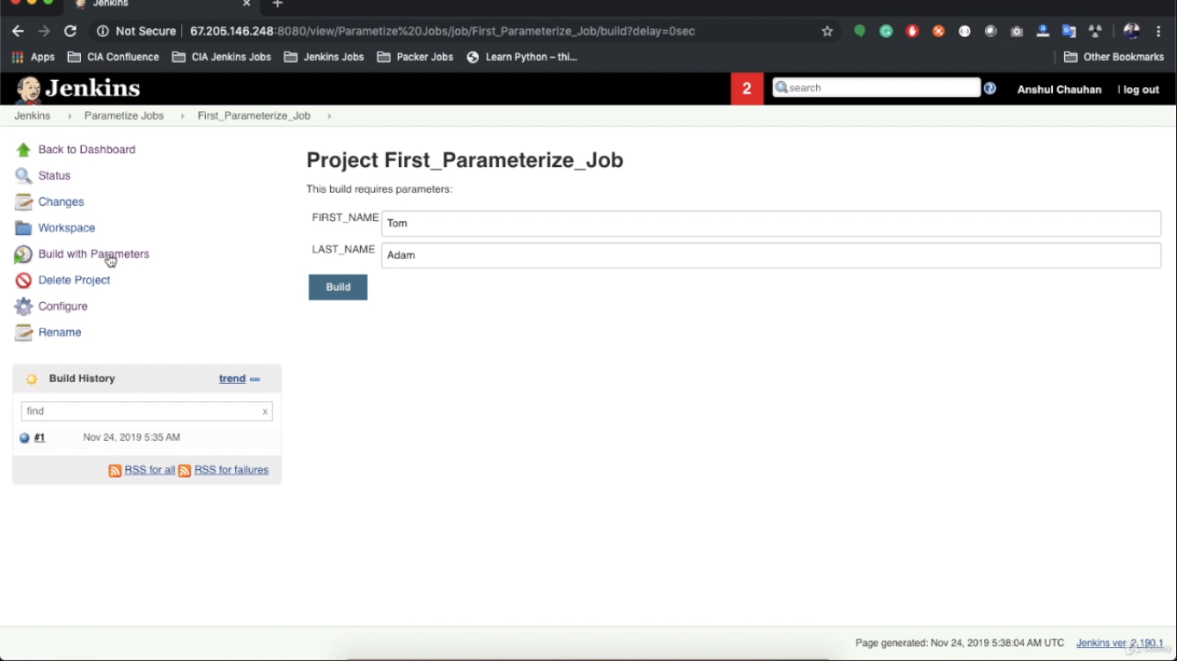

Slide 78



Slide 79


Slide 80


Slide 81


Slide 82


Slide 83


Slide 84


Slide 85


Slide 86


Slide 87


Slide 88


Slide 89


Slide 90


Slide 91


Slide 92


Slide 93


